Slide 2
develop understanding about basics of races,
derive important facts and formulae relating to various problems on races,
solve various problems relating to races.

Slide 3
Basics, Important Facts & Formulae
Race
  A contest of Speed
  Running/Driving/Riding/Sailing/Rowing
  Specified Distance
Racecourse
  Ground/Path
  Contests - Arranged

Slide 4
Basics, Important Facts & Formulae
Starting Point
  Race – Begins/Start
Winning Post/Goal
  Race – Finishes/Ends
Winner
  First Reaches - Finishing Point

Slide 5
Basics, Important Facts & Formulae
Dead-heat Race
  All the persons contesting a race
  Reach finishing point - Same time (exactly)

Slide 6
Basics, Important Facts & Formulae
A & B - Two Contestants
A beats B by ‘t’ seconds.
  A finishes the race ‘t’ seconds before B finishes.
A gives B a start of ‘t’ seconds.
  A starts ‘t’ seconds after B starts from the same point.

Slide 7
Basics, Important Facts & Formulae
A & B - Two Contestants
A gives B a start of ‘d’ m.
  While A starts at the starting point, B starts ‘d’ m ahead from the starting point at the same time.

Slide 8
Basics, Important Facts & Formulae
A & B - Two Contestants
Game of 100
  A game in which the participant scoring 100 points first is the winner.
In a game of 100, ‘A can give B 20 points’
  While A scores 100 points, B scores only (100–20) or 80 points.

Slide 9
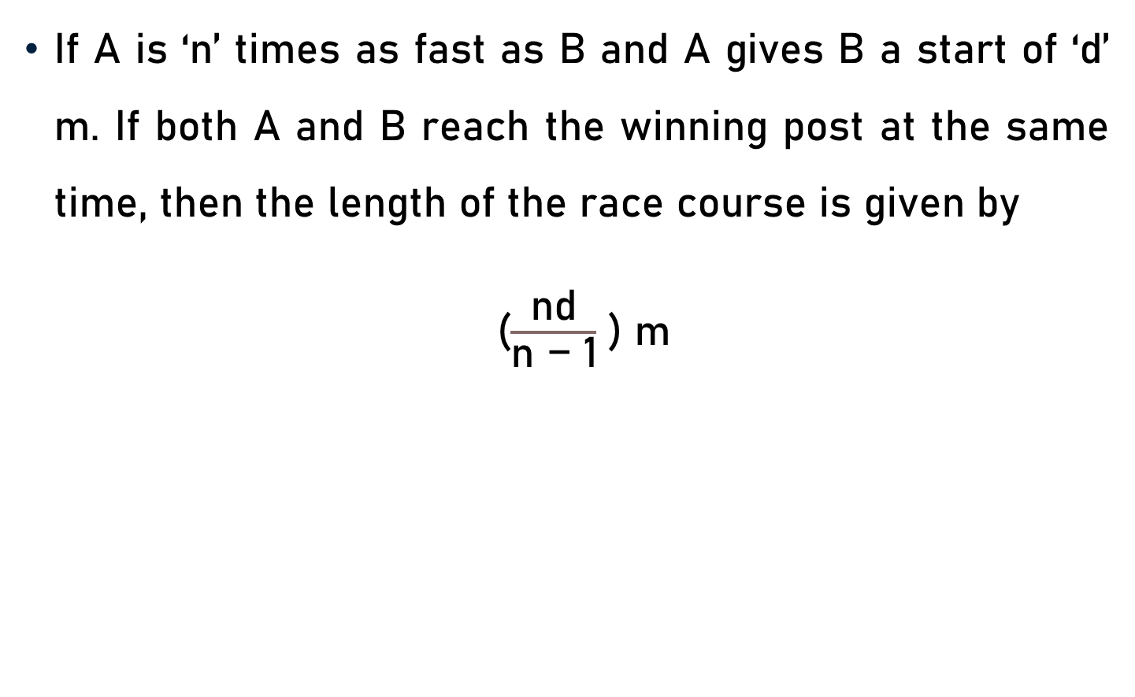
Basics, Important Facts & Formulae
If A is ‘n’ times as fast as B and A gives B a start of ‘d’ m. If both A and B reach the winning post at the same time, then the length of the race course is given by
($\frac{\text{nd}}{\text{n}\text{ − }\text{1}}$ ) m

Slide 10
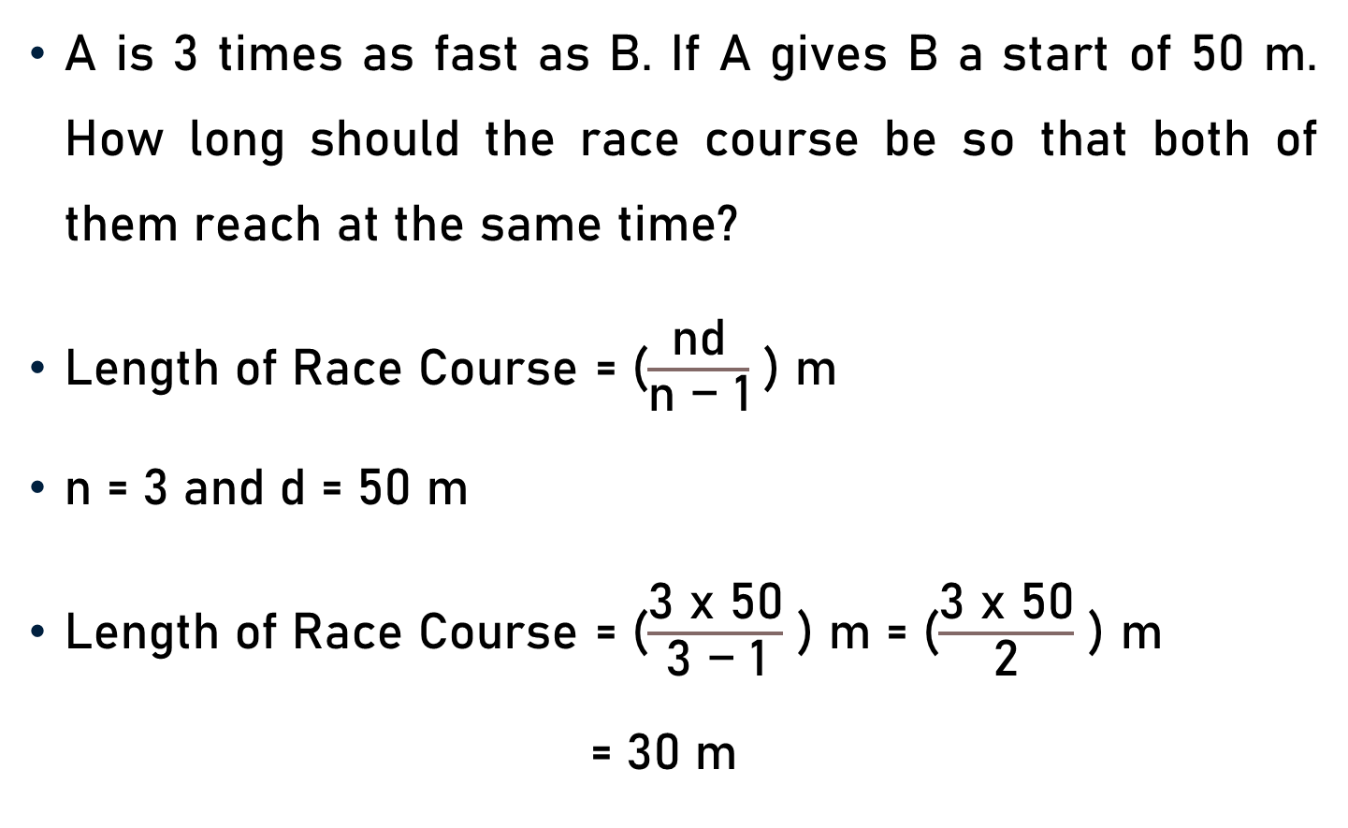
Problem 1
A is 3 times as fast as B. If A gives B a start of 50 m. How long should the race course be so that both of them reach at the same time?
Length of Race Course = ($\frac{\text{nd}}{\text{n}\text{ − }\text{1}}$ ) m
n = 3 and d = 50 m
Length of Race Course = ($\frac{\text{3 }\text{x}\text{ 50}}{\text{3}\text{ − }\text{1}}$ ) m = ($\frac{\text{3 }\text{x}\text{ 50}}{\text{2}}$ ) m
= 30 m
10

Slide 11
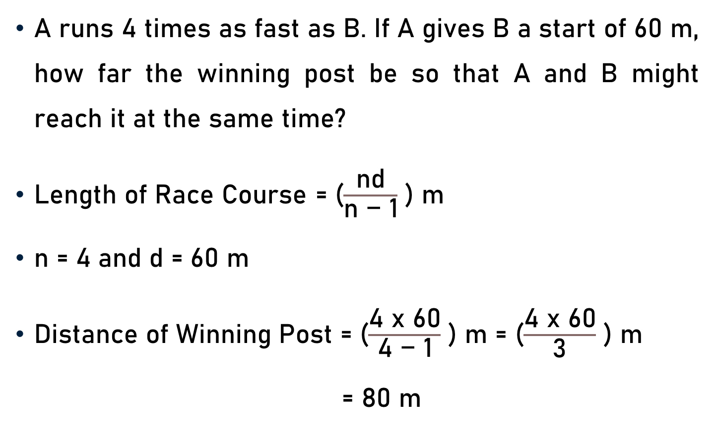
Problem 2
A runs 4 times as fast as B. If A gives B a start of 60 m, how far the winning post be so that A and B might reach it at the same time?
Length of Race Course = ($\frac{\text{nd}}{\text{n}\text{ − }\text{1}}$ ) m
n = 4 and d = 60 m
Distance of Winning Post = ($\frac{\text{4 }\text{x}\text{ 60}}{\text{4}\text{ − }\text{1}}$ ) m = ($\frac{\text{4} \text{x}\text{ 60}}{\text{3}}$ ) m
= 80 m
20

Slide 12

Basics, Important Facts & Formulae
If A can run ‘d’ m race in ${\text{t}}_{1}$seconds and B in ${\text{t}}_{2}$ seconds (where ${\text{t}}_{1}$< ${\text{t}}_{2}$), then A beats B by a distance of
$\frac{\text{(}\text{d}\text{)(}{{\text{t}}_{2} \text{− }\text{t}}_{1}\text{)}}{\text{(}{\text{t}}_{2}\text{)}}$ m

Slide 13
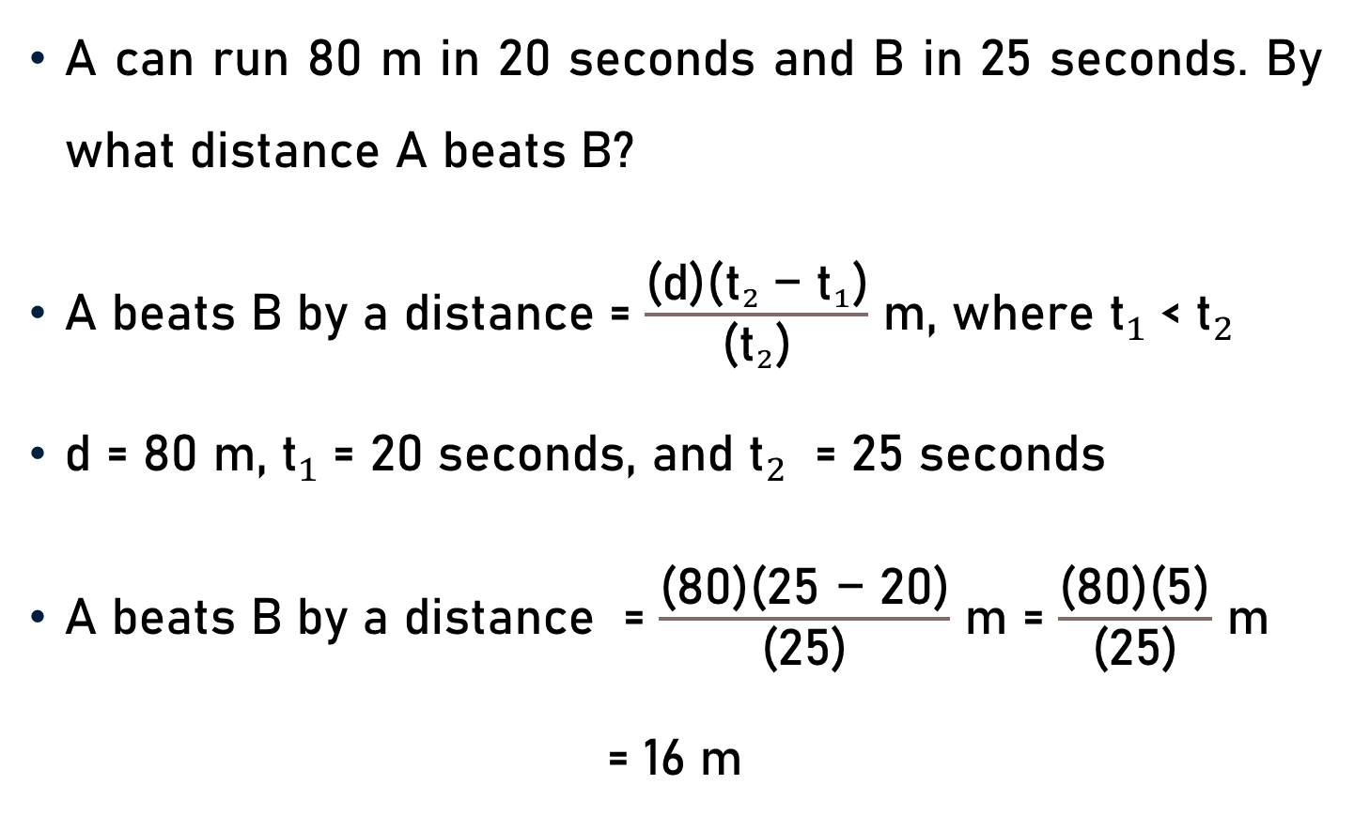
Problem 3
A can run 80 m in 20 seconds and B in 25 seconds. By what distance A beats B?
A beats B by a distance = $\frac{\text{(}\text{d}\text{)(}{{\text{t}}_{2} \text{− }\text{t}}_{1}\text{)}}{\text{(}{\text{t}}_{2}\text{)}}$ m, where ${\text{t}}_{1}$< ${\text{t}}_{2}$
d = 80 m, ${\text{t}}_{1}$= 20 seconds, and ${\text{t}}_{2}$ = 25 seconds
A beats B by a distance = $\frac{\text{(}\text{8}\text{0}\text{)(}\text{25 − 20}\text{)}}{\text{(}\text{25}\text{)}}$ m = $\frac{\text{(}\text{8}\text{0)(}\text{5}\text{)}}{\text{(}\text{25}\text{)}}$ m
= 16 m
16
5

Slide 14
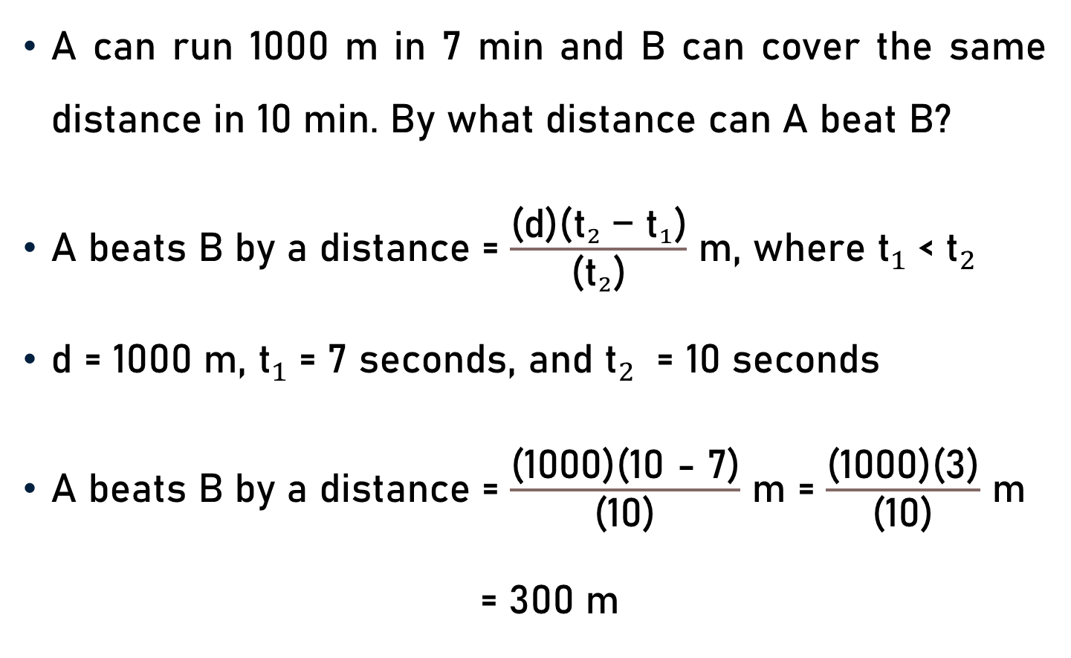
Problem 4
A can run 1000 m in 7 min and B can cover the same distance in 10 min. By what distance can A beat B?
A beats B by a distance = $\frac{\text{(}\text{d}\text{)(}{{\text{t}}_{2} \text{− }\text{t}}_{1}\text{)}}{\text{(}{\text{t}}_{2}\text{)}}$ m, where ${\text{t}}_{1}$< ${\text{t}}_{2}$
d = 1000 m, ${\text{t}}_{1}$= 7 seconds, and ${\text{t}}_{2}$ = 10 seconds
A beats B by a distance = $\frac{\text{(}\text{1000}\text{)(}\text{10 − 7}\text{)}}{\text{(}\text{10}\text{)}}$ m = $\frac{\text{(}\text{100}\text{0)(}\text{3}\text{)}}{\text{(}\text{10}\text{)}}$ m
= 300 m

Slide 15
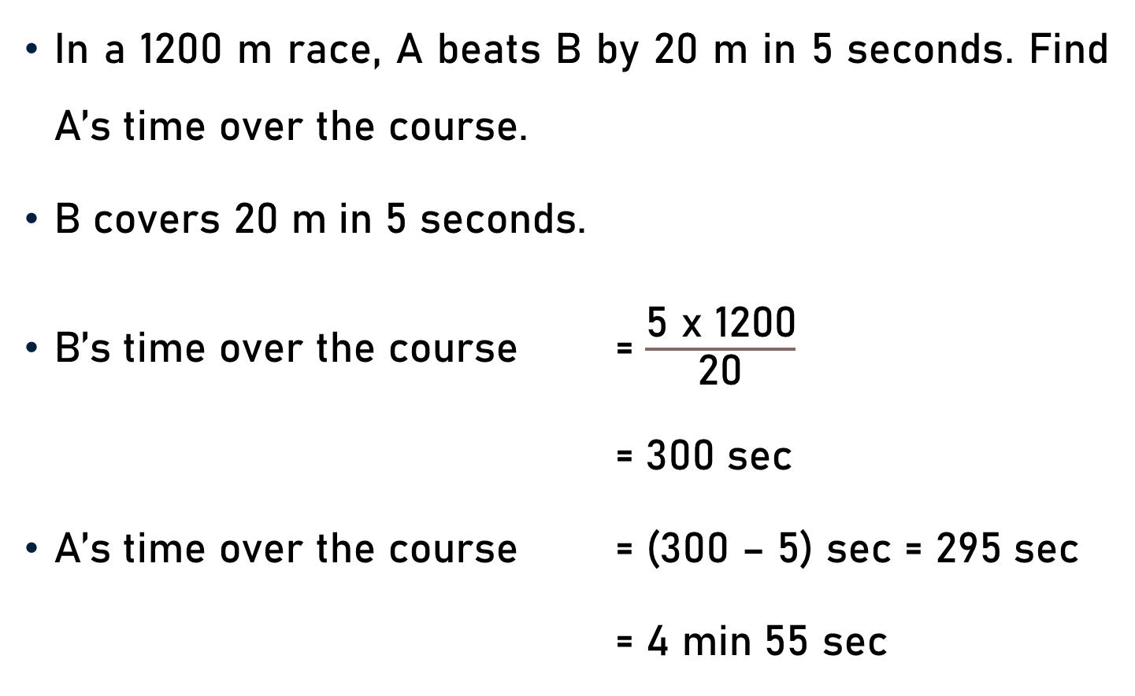
Problem 5
In a 1200 m race, A beats B by 20 m in 5 seconds. Find A’s time over the course.
B covers 20 m in 5 seconds.
B’s time over the course = $\frac{\text{5 }\text{x}\text{ 12}\text{00}}{\text{20}}$
= 300 sec
A’s time over the course = (300 – 5) sec = 295 sec
= 4 min 55 sec
60

Slide 16
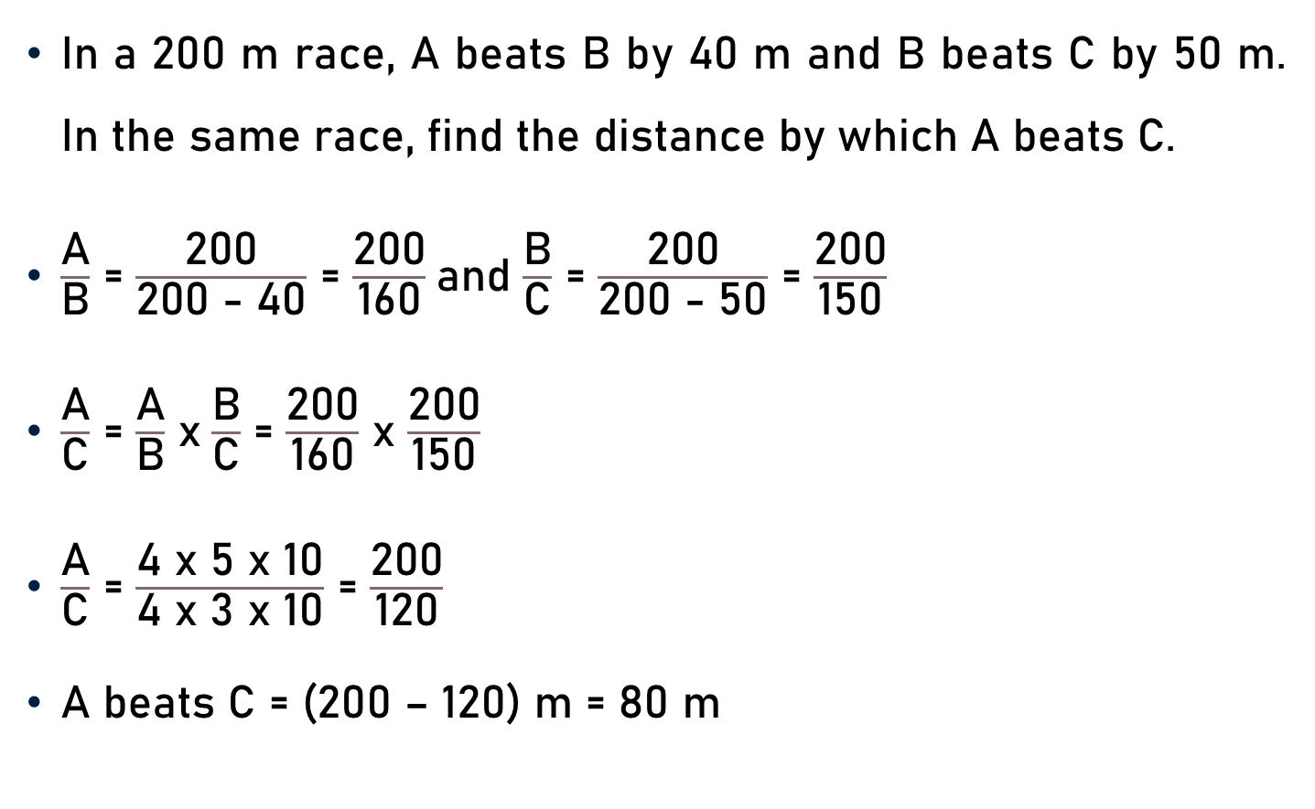
Problem 6
In a 200 m race, A beats B by 40 m and B beats C by 50 m. In the same race, find the distance by which A beats C.
$\frac{\text{A}}{\text{B}}$ = $\frac{\text{200}}{\text{200 − 4}\text{0}}$ = $\frac{\text{200}}{\text{160}}$and $\frac{\text{B}}{\text{C}}$ = $\frac{\text{2}\text{00}}{\text{200 − 5}\text{0}}$ = $\frac{\text{200}}{\text{1}\text{5}\text{0}}$
$\frac{\text{A}}{\text{C}}$ = $\frac{\text{A}}{\text{B}}$ x$\frac{\text{B}}{\text{C}}$ = $\frac{\text{2}\text{00}}{\text{1}\text{6}\text{0}}$ x $\frac{\text{2}\text{00}}{\text{150}}$
$\frac{\text{A}}{\text{C}}$ = $\frac{\text{4 }\text{x}\text{ 5 }\text{x}\text{ 1}\text{0}}{\text{4 }\text{x}\text{ 3 }\text{x}\text{ 1}\text{0}}$ = $\frac{\text{200}}{\text{120}}$
A beats C = (200 – 120) m = 80 m
4
5
3
4

Slide 17
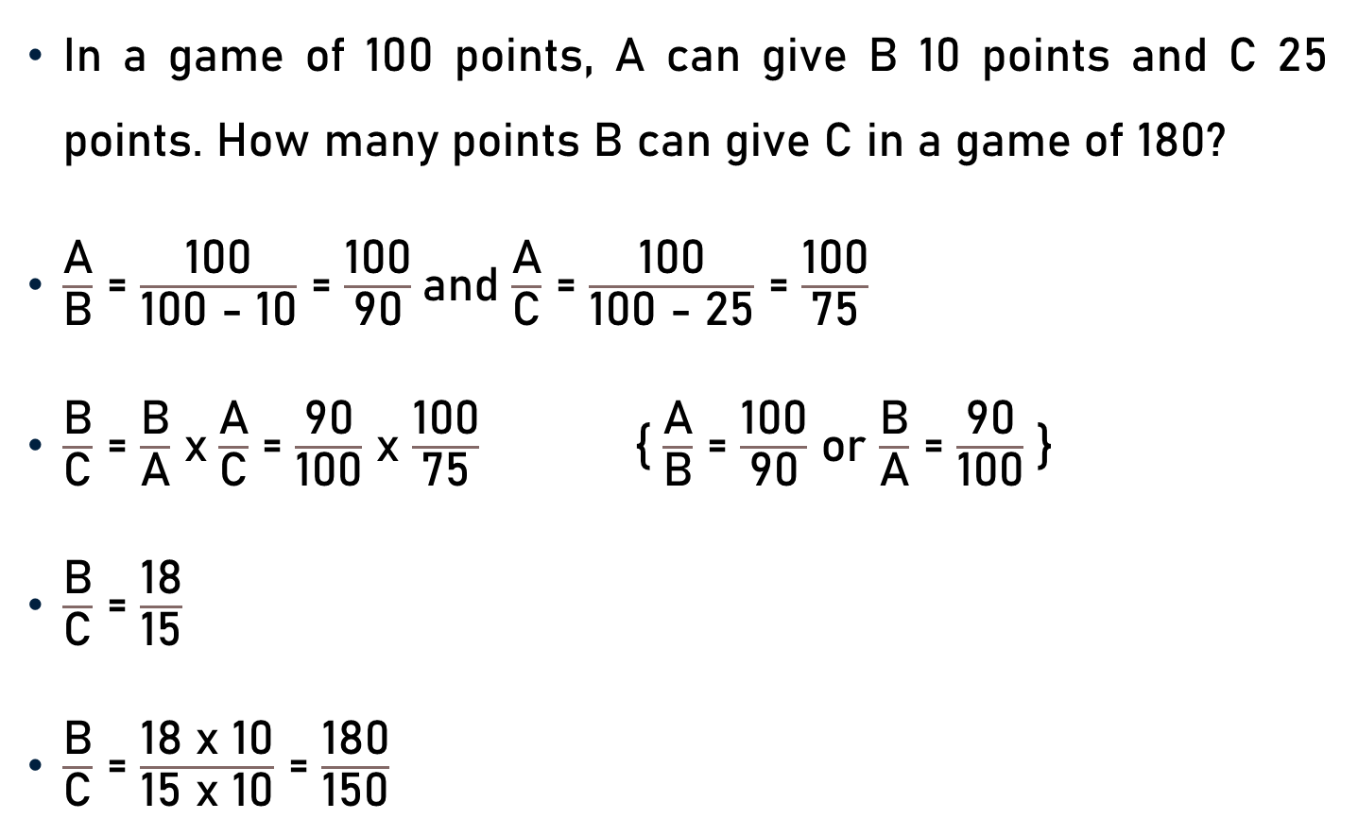
Problem 7
In a game of 100 points, A can give B 10 points and C 25 points. How many points B can give C in a game of 180?
$\frac{\text{A}}{\text{B}}$ = $\frac{\text{1}\text{00}}{\text{1}\text{00 − 1}\text{0}}$ = $\frac{\text{1}\text{00}}{\text{9}\text{0}}$and $\frac{\text{A}}{\text{C}}$ = $\frac{\text{1}\text{00}}{\text{1}\text{00 − 2}\text{5}}$ = $\frac{\text{1}\text{00}}{\text{75}}$
$\frac{\text{B}}{\text{C}}$ = $\frac{\text{B}}{\text{A}}$ x$\frac{\text{A}}{\text{C}}$ = $\frac{\text{9}\text{0}}{\text{1}\text{0}\text{0}}$ x $\frac{\text{1}\text{00}}{\text{7}\text{5}}$ { $\frac{\text{A}}{\text{B}}$ = $\frac{\text{1}\text{00}}{\text{90}}$ or $\frac{\text{B}}{\text{A}}$ = $\frac{\text{9}\text{0}}{\text{10}\text{0}}$ }
$\frac{\text{B}}{\text{C}}$ = $\frac{\text{18}}{\text{1}\text{5}}$
$\frac{\text{B}}{\text{C}}$ = $\frac{\text{18 }\text{x}\text{ 10}}{\text{1}\text{5 }\text{x}\text{ 10}}$ = $\frac{\text{18}\text{0}}{\text{1}\text{5}\text{0}}$
18
15

Slide 18

Problem 7
$\frac{\text{B}}{\text{C}}$ = $\frac{\text{18}\text{0}}{\text{1}\text{5}\text{0}}$
B can give C (180 – 150 = 30) points in a game of 180.

Slide 19
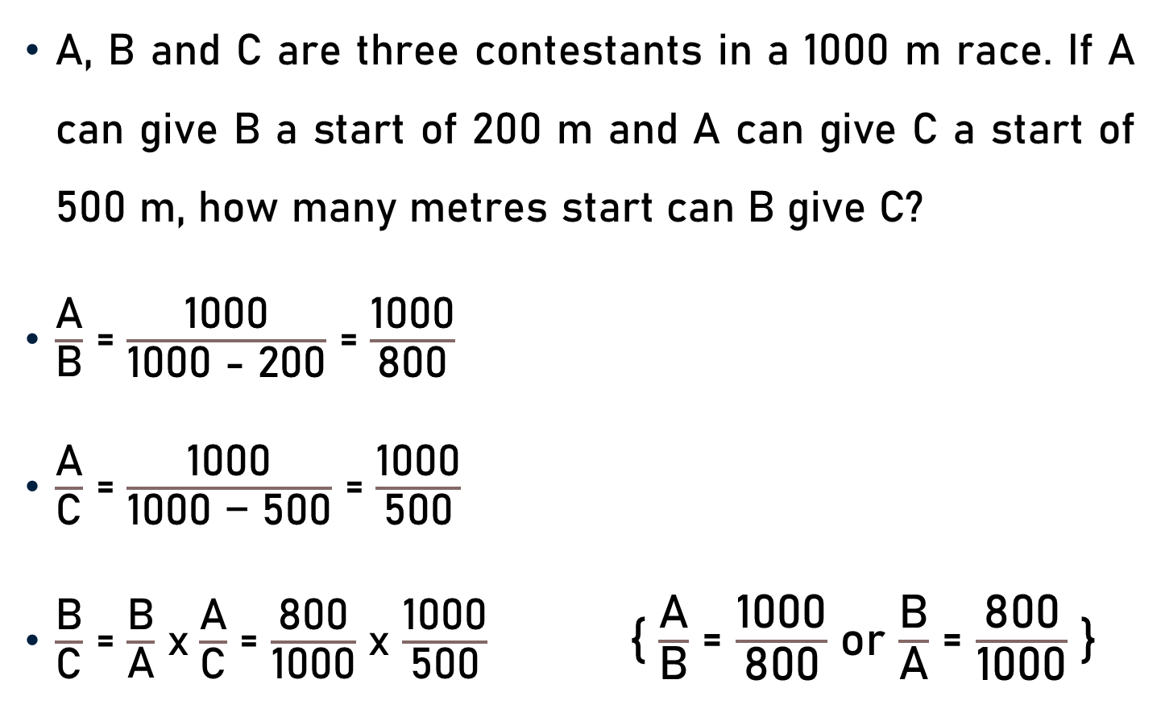
Problem 8
A, B and C are three contestants in a 1000 m race. If A can give B a start of 200 m and A can give C a start of 500 m, how many metres start can B give C?
$\frac{\text{A}}{\text{B}}$ = $\frac{\text{10}\text{00}}{\text{1}\text{00}\text{0}\text{ − 200}}$ = $\frac{\text{10}\text{00}}{\text{8}\text{0}\text{0}}$
$\frac{\text{A}}{\text{C}}$ = $\frac{\text{10}\text{00}}{\text{1}\text{00}\text{0}\text{ − }\text{5}\text{00}}$ = $\frac{\text{10}\text{00}}{\text{5}\text{0}\text{0}}$
$\frac{\text{B}}{\text{C}}$ = $\frac{\text{B}}{\text{A}}$ x$\frac{\text{A}}{\text{C}}$ = $\frac{\text{8}\text{00}}{\text{1}\text{00}\text{0}}$ x $\frac{\text{10}\text{00}}{\text{5}\text{0}\text{0}}$ { $\frac{\text{A}}{\text{B}}$ = $\frac{\text{1}\text{0}\text{0}\text{0}}{\text{80}\text{0}}$ or $\frac{\text{B}}{\text{A}}$ = $\frac{\text{80}\text{0}}{\text{10}\text{0}\text{0}}$ }
8
5

Slide 20

Problem 8
$\frac{\text{B}}{\text{C}}$ = $\frac{\text{8}}{\text{5}}$
$\frac{\text{B}}{\text{C}}$ = $\frac{\text{8 }\text{x}\text{ 125}}{\text{5 }\text{x}\text{ 125}}$ = $\frac{\text{1}\text{00}\text{0}}{\text{625}}$
B can give C a start of (1000 – 625) m = 375 m

Slide 21
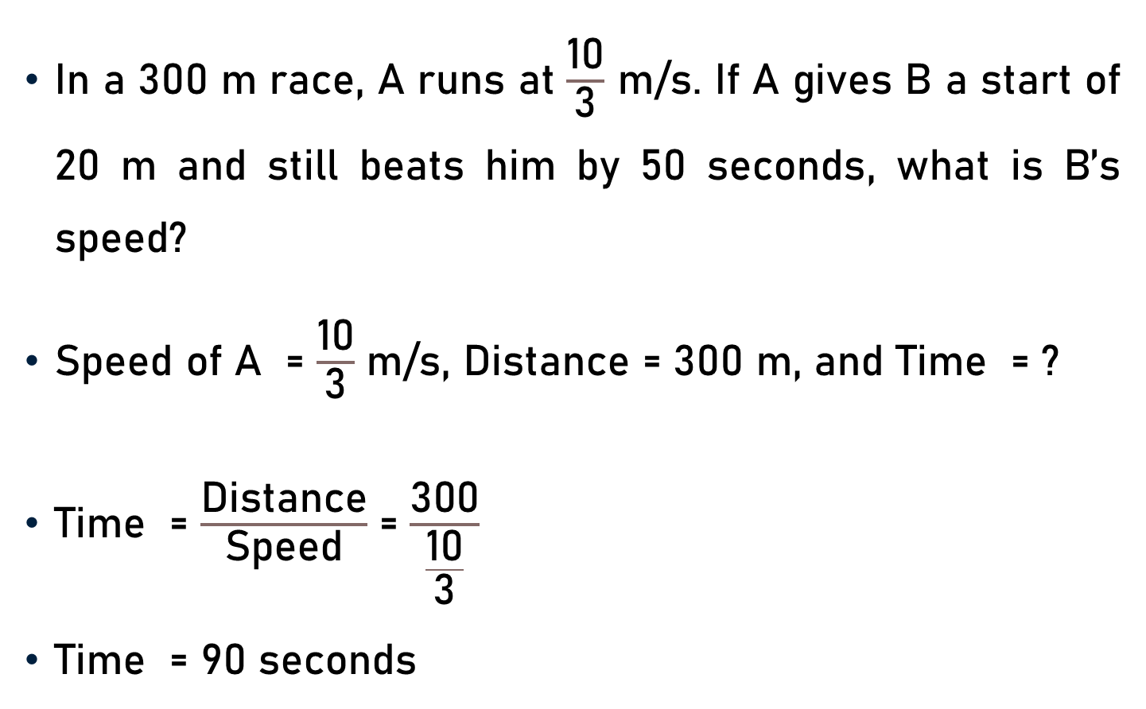
Problem 9
In a 300 m race, A runs at $\frac{\text{10}}{\text{3}}$ m/s. If A gives B a start of 20 m and still beats him by 50 seconds, what is B’s speed?
Speed of A = $\frac{\text{1}\text{0}}{\text{3}}$ m/s, Distance = 300 m, and Time = ?
Time = $\frac{\text{Distance}}{\text{Speed}}$ = $\frac{\text{300}}{\frac{\text{10}}{\text{3}}}$
Time = 90 seconds
30

Slide 22
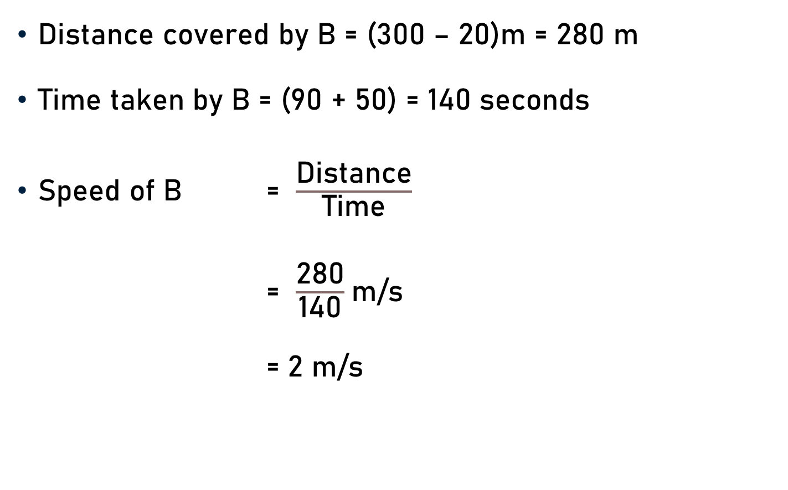
Problem 9
Distance covered by B = (300 – 20)m = 280 m
Time taken by B = (90 + 50) = 140 seconds
Speed of B = $\frac{\text{Distance}}{\text{Time}}$
= $\frac{\text{280}}{\text{140}}$m/s
= $\text{2}$ m/s
2

Slide 23
Conclusion
Race (A contest of Speed)
Racecourse (Ground/Path)
Starting Point (Begins/Start)
Winning Post/Goal (Finishes/Ends)
Winner (First Reaches - Finishing Point)
Dead-heat Race (Reach finishing point - Same time)

Slide 24
Conclusion
A beats B by ‘t’ seconds.
A gives B a start of ‘t’ seconds.
A gives B a start of ‘d’ m.
Game of 100.
In a game of 100, A can give B 20 points.

Slide 25
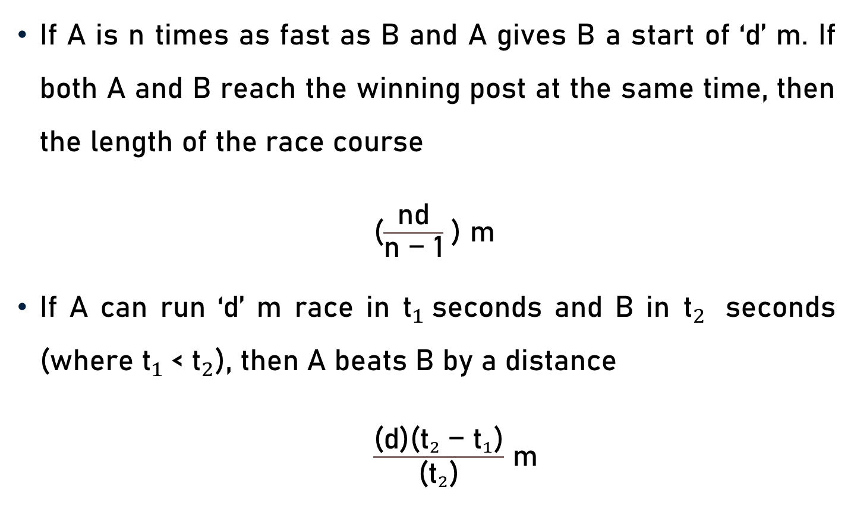
Conclusion
If A is n times as fast as B and A gives B a start of ‘d’ m. If both A and B reach the winning post at the same time, then the length of the race course
($\frac{\text{nd}}{\text{n}\text{ − }\text{1}}$ ) m
If A can run ‘d’ m race in ${\text{t}}_{1}$seconds and B in ${\text{t}}_{2}$ seconds (where ${\text{t}}_{1}$< ${\text{t}}_{2}$), then A beats B by a distance
$\frac{\text{(}\text{d}\text{)(}{{\text{t}}_{2} \text{− }\text{t}}_{1}\text{)}}{\text{(}{\text{t}}_{2}\text{)}}$ m

Slide 26
Summary
Race
  Basics
  Important Facts
  Formulae
  Problems

